Slide 1

Compyle
Fields, Files, & Formatting Release
Improving the Flow of Data Into and Out of Compyle
August 2023

Slide 2

Introduction & Welcome
Thank you to our customers, beta users, & staff who have all provided feedback that we are using to make Compyle even better.
Please send future feature suggestions to the Compyle, Control, & Scorecard support team at support@clearimpact.com.

Slide 3
Agenda: Upgrade Overview
Introduction: Tools for Cleaner Data
  Improving Data Quality at Entry
  Enhancing Data Exports
Files
  Documents tab
  My Downloads
  Admin: Data Downloads
Field Types
  File field
  Likert Scale
  Time am/pm
  URL & Email fields
Formatting
  Phone Numbers
  Radio Button yes/no option
  Number Fields (data entry & display)
Min & Max
  Word Counts
  Numeric Values
Assorted Refinements
  Referral buttons & Referral network
  Scorecard Feeds
  Navigation improvements & Things work better
Conclusion
Questions & Answers

Slide 4
The Data Must Flow
Setting Clear Expectations: Improving Data Quality at Entry
It’s easier to get the information you’re looking for, if people can tell what you need from them.
New field types to more efficiently gather data
Display and formatting options guide users to enter usable data
Minimum and maximum limits ensure data falls within desired parameters.
Putting It All in One Place: Enhancing Data Exports
There are almost twenty places you can export data from having a centralized home for those exports will help you keep track of where that data came from and when.
Exports run behind the scenes to better support large data sets.
New My Downloads page and Data Downloads pages make it easier to keep track of downloads
Compyle-to-Scorecard Feeds scheduled feeds will run more efficiently.

Slide 5

Files: Uploads & Downloads

Slide 6
Files: Document Tab
Increased File Size
  From 5 Mb to 100 MB per file
  Now matches Scorecard file size limits
Expanded File Types Allowed
  Old list: xlsx, xls, docx, jpg, pdf, txt, html, doc, pptx, png
  Now: all types allowed except application files (not allowed: .exe, cmd, run, js, json, sh, xml, python, xml, git, yml, sql,vbs, etc)
Customer Requested Feature Enhancement
This nonprofit provides resources for bullied youth and their adults. Often there is video or audio evidence of the bullying that needs to be connected to the participant’s record. Those files are usually large and in formats Compyle could not accept until now. With this change Compyle can hold the full case file with all of the related files and case notes in one place that is securely accessible online.
  Benefits: Compyle can now accept much larger files and many more types so that users do not have to edit files or split them before uploading. This makes it easier to have all the attachments for a participant in their folder in Compyle so it can be accessed anywhere.

Slide 7
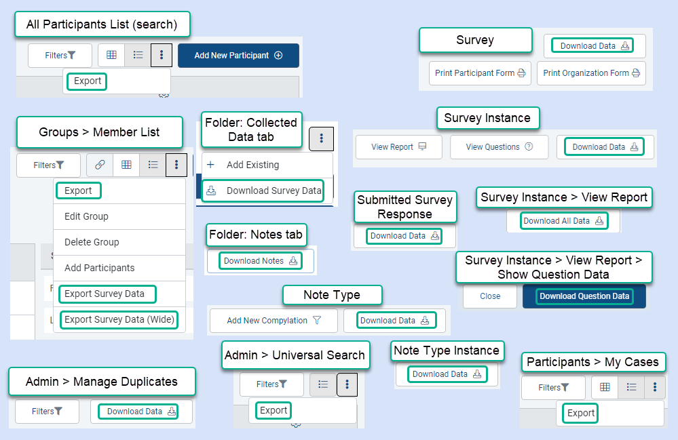
Some of the Downloads & Exports in Compyle

Slide 8
My Downloads & Data Downloads
All exports and data downloads save to the My Downloads page for each user and the Admin Data Downloads page.
Downloads can take 0-15 minutes to complete as this is an automated process.
My Downloads is specific to each user
Data Downloads is for the whole site and limited to administrators
Users can choose to receive an email when their files are ready. One email sends for each file, so this an opt-in setting.
Files will remain available for at least 30 days but may be removed to after that to conserve storage space and keep the lists from growing too big.
Exceptions
  Import templates, which only have one row of data
  Downloading documents from the Participant folder
  Downloading attached files from Survey Responses
  Export graph in Compylations
  Export data table in Compylations
  Benefits: Handle large data sets. Avoid accidentally exporting the same file over again. Have an option to generate a download now but wait to access the file until you are on a more secure device.

Slide 9
My Downloads
Data Collections > My Downloads
The downloaded files list is broken up into categories based on the kind of export.
  Participants and Organizations
  Surveys and Data Forms
  Notes
  Scorecard Feeds
Users can choose to receive an email when their files are ready.
  One email sends for each file, so this an opt-in setting.
Benefits: Handle large data sets. Avoid accidentally exporting the same file over again. Have an option to generate a download now but wait to access the file until you are on a more secure device.

Slide 10
Data Downloads
Admin > Data Downloads
The downloaded files list is broken up into categories based on the kind of export.
  Participants and Organizations
  Surveys and Data Forms
  Notes
  Scorecard Feeds
  Admin Tools
Files will show as “Viewed” if anyone has downloaded that file, such as the user who requested it.
Benefits: See what files your users have requested for download. Export large data sets once and allow multiple admins to access the download. Avoid accidentally exporting the same file over again. Have an option to generate a download now but wait to access the file until you are on a more secure device.

Slide 11

Field Types

Slide 12
File Field Type
Allows users to attach one file per field
A survey form can have more than one file field. (We recommend a max of 5.)
Participant and Survey forms only for now (We hope to add support for notes and public forms, too.
Allowed File Types
Text (doc,docx,pdf,txt,gdoc,odt)
Spreadsheet (csv,tsv,xls,xlsx,gsheet,ods)
Presentation (ppt,pptx,ppsm,ppotx,gslides,odp)
Image (png,jpg,jpeg,gif,bmp,svg,tiff,tif)
Media (wmv,mp3,mp4,mov,gif,webm,mpeg,mpg,mpe,mp1,mp2)
Benefit: Allow participants to submit documents when completing a survey form. Get more information at once and more easily identify the documents you have.

Slide 13
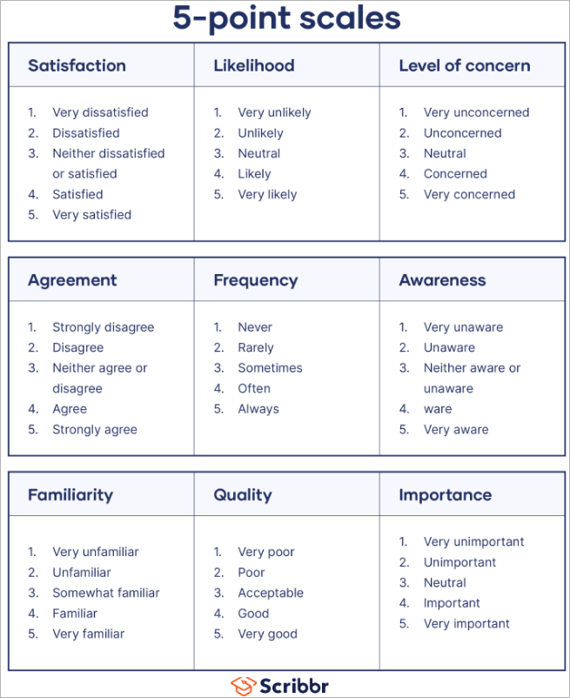
Likert Scale Field Type
A standard survey question style with an odd number of text choices displayed along a horizontal line according to values assigned to the text.
Only a single option can be selected.
Limit of seven options per field
On multi-entry forms and small screens, displays as radio button field
Benefit: Present options more concisely and in a familiar format. More input variety to keep respondents engaged.
Bhandari, P. & Nikolopoulou, K. (2023, June 22). What Is a Likert Scale? | Guide & Examples. Scribbr. Retrieved August 21, 2023, from https://www.scribbr.com/methodology/likert-scale/

Slide 14


Time Field Type
New 12-hour time format with am/pm setting
For capturing the time when something happened
This is a new field. The existing “Time” field is now “Time Spent.” That field type collects hours and minutes without the time-of-day indicator.
Benefit: Make it easier to track when an activity occurred. Gather more precise time information.
New Time Field = Time of Day
Time Spent Field = How long

Slide 15



URL and Email Field Types
URL field:
Enter a website
On saved records
  Link to open site
  Copy Link button
Email field:
Enter an email address (validation for format)
On saved records
  Send Email button
  Copy Email Button
Benefit: Websites and emails are collected in a valid format. Users can easily copy that information for use outside of Compyle.

Slide 16
Formatting Options

Slide 17
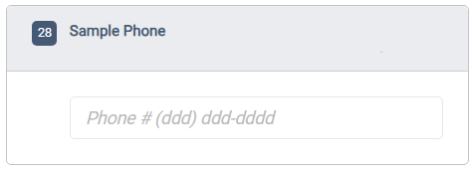
Phone Number (Short Answer Field Type)
Display style: (ddd) ddd-dddd
Enter numbers in this field, and the system will display them in a standard U.S. format.
Can be turned on for existing custom phone fields (Saved entries will not be changed unless the record is edited.)
  Benefit: Phone numbers are more readable on saved records, in search, and in the folder info pane.
A hotfix release is coming for the standard Participant Phone field so nonstandard entries will display again on saved records.
Saved entries will display below the field input a long with a copy button and a “call number” link for easier access.

Slide 18
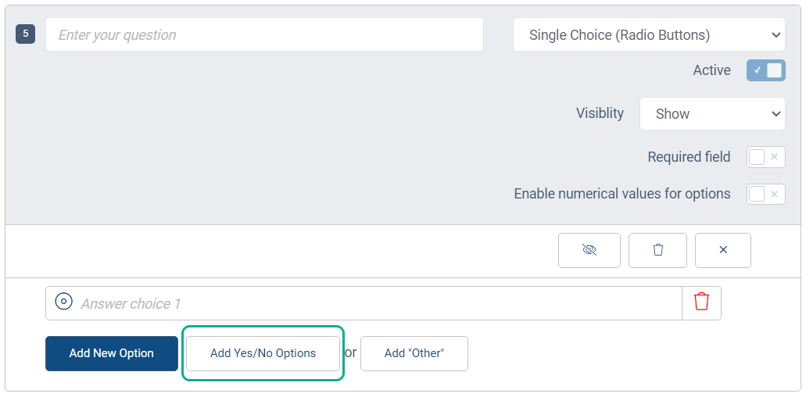
Yes/No (Radio Button Field Type)
The Add Yes/No Options button adds two answer choices, Yes and No, with one click.
Benefit: Easier to create many Yes/No fields very quickly.

Slide 19
Numeric Fields
Unspecified
  Default setting for Number fields
Whole Number
  Integer (whole number) values only
  Options: display commas, allow negative numbers
Decimal
  A number with 1, 2, or 3 decimal places (tenths, hundredths, thousandths)
  Options: display commas, allow negative numbers, decimal places
Percent
  A number with a percent sign displayed after the value
  Options: 0-3 decimal places, allow negative numbers
Currency
  A number preceded by a currency symbol
  Options: 0-3 decimal places, symbol: US $, Australian $, Canadian $, New Zealand $, EU €, British Pound
Benefit: Gather more precise numeric data. Ensure that values are of the expected type.

Slide 20

Minimum & Maximum Limits

Slide 21
Min & Max Value for Number Fields
Min: Smallest acceptable value for the field
  Leave blank for no limit
  To allow values less than zero, select the Allow Negative option
  Formatting should match option settings (decimals and commas must be enabled to use in the Min value)
Max: Largest acceptable value for the field
  Leave blank for no limit
  Formatting should match option settings (decimals and commas must be enabled to use in the Max value)
  Benefit: Set users up for success by ensuring they can only enter appropriate values for the number fields.

Slide 22
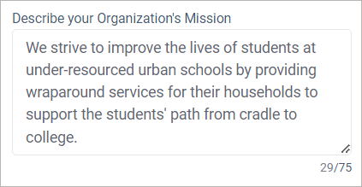
Min & Max Word Count (Paragraph, Short Answer)
Option for text entry fields: Short Answer and Paragraph
For counts, a word is one or more characters follow by blank space
Min:
  Blank is unlimited
  Number greater than 0
Max:
  Blank is unlimited
  Number greater than 0
For no limit, uncheck the Limit Word Count option.
Benefit: Easier to create many Yes/No fields very quickly.
Example of Word Limit in Data Entry Mode

Slide 23
Assorted Improvements

Slide 24
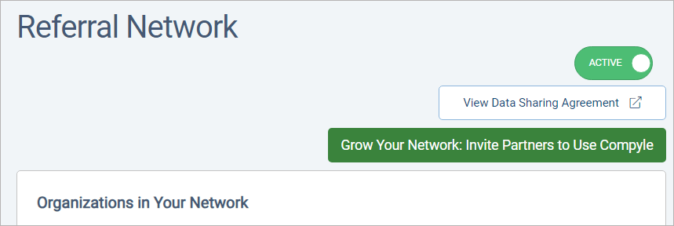
Referral Buttons
  Refer Clear Impact button in top nav bar:
  Help organizations who could use Compyle/Scorecard connect with Clear Impact
Grow Your Network Button
  Referral network module: Referral Network page
  Instance Settings: Referral Network setting

Slide 25
Various Improvements
Scorecard Feeds
  Rename saved feeds
  Scheduled feeds will run in sets of 100 per hour overnight
Data Entry
  Double quotes entered in paragraph fields do not cause problems with viewing saved records.
  Age calculation can handle pre-1900 entries
  Hidden group fields no longer show in folder info pane
  Mobile view from emailed survey link will now display description fields
  Archiving participants and organizations removes them survey responders list & correctly adjusts the survey stats in view mode
  Cleaning up the Missing Required Fields messaging more
  Navigation
  Permalinks to participant folders work again.
  My Cases (clear filters, filter fields, etc)
  Create Group -> Cancel button returns you to the group list
  Breadcrumbs/navigation blue links are not clickable before data to render the link loads
  Benefit: Things work better so users are happier and can more easily do what they need to do

Slide 26

Conclusion
Wow, those are a lot of changes to help improve Compyle data entry, data quality, and navigation!
What’s next: Form Logic (rules that apply within a form to conditionally show/hide/require fields).
The next release is going to be worked on in smaller, more contained “sprints” as a single form logic rule can have broad effects.
That means we will develop a key function, test it with all of the field types in each of the data entry modes with all supported browsers and devices.
Then we may release it or add a new function and retest. This may result In a series of smaller more focused releases.

Slide 27
Resource Links
Documentation
My Downloads: per user exports: https://support.clearimpact.com/en/my-downloads
Data Downloads: all site exports: https://support.clearimpact.com/en/data-downloads
Release Notes: https://support.clearimpact.com/en/compyle-release-notes-august-2023
Compyle Design: Field Types: pictures of field types in edit mode and entry mode: https://support.clearimpact.com/en/compyle-implementation-field-types
Sample Fields Template Survey
Request a copy of a survey with one of each field type from support@clearimpact.com.

Slide 28
Q & A
Any questions?

