Slide 1

Compyle
Form Logic & Form Management Layout
Form Logic Rules, Form Management Folder, Communication Tools,
February 2024

Slide 2

Introduction & Welcome
Thank you to our customers, beta users, & staff who have all provided feedback that we are using to make Compyle even better.
Please send future feature suggestions to the Compyle, Control, & Scorecard support team at support@clearimpact.com.

Slide 3
Agenda: Upgrade Overview
Introduction:
  Engagement & Communication
  Improved Data Entry & Form Editing
Form Management Folder
  Layout for Survey Forms & Note Type Forms
  Tabs for Instances, Fields, Logic Rules, Settings, History
Form Logic Rules
  Creating Rules
  Editing, Copying, and Archiving rules
  Usage Examples
User Communication Tools
  Share Menu & QR Code generator
  User Confirmation Email
  Unsaved Changes Warning
  Alert Templates
Refinements & Repairs
  Scorecard Feeds to Variable Measures
  Performance & security improvements
Conclusion
  Resources & Reminders
  Questions & Answers

Slide 4
Engagement & Communication
Interactive Forms:
Conditional logic rules can be added to Compyle's survey forms and note forms. This will allow you to make responsive forms that change as users enter information so that you can ask questions when and if they are needed.
User Communication Tools:
We are also expanding your user communication tools and simplifying survey management through an improved interface.

Slide 5
Better Data Entry & Form Editing
Form Management Interface:
Compyle now has separate tabs for managing different aspects of survey forms and note forms. This simplified interface is intended to make it easier to focus on the form changes you need to make.
Form Logic & Data Entry:
With rules, you can reduce how many fields users see on the forms they use everyday and conditionally require fields only when needed.. This can help ensure that the right information is collected while also streamlining the data entry process.

Slide 6

Form Management Folder for Survey Forms & Note Type Forms

Slide 7
Managing Survey & Note Forms
Form Management Folder
Redesigned layout with tabbed form folder
Menus:
      Form Information panel
      Share and Analyze menus
Tabs
Instances tab
Question Fields tab
Form Logic Rules tab
Settings tab
History tab
  Benefits: Cleaner, easier to navigate

Slide 8
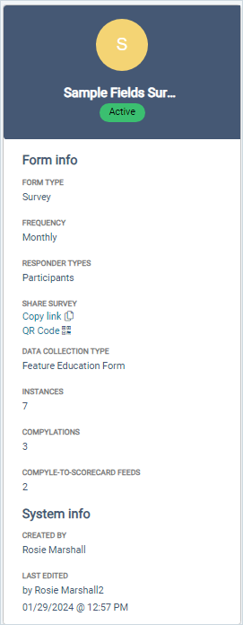
Form Info Panel
  Form type: Survey or Note Type Form
  Frequency: The time period or calendar, such as monthly or annual.
  Responder Types: Participants, Organizations, Anonymous
  Share Survey: Copy link, Get QR Code
  Data Collection Type: The category for the survey form
  Instances: Count of instances or different time periods when information was gathered
  Compylations: Count of analytics reports using this survey form
  Compyle-to-Scorecard Feeds: Count of summary data transfers to Scorecard using data from this form
  System Info: Who created the form. Who last updated it. When it was last edited.

Slide 9
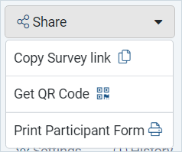
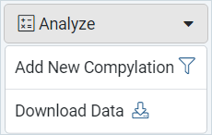
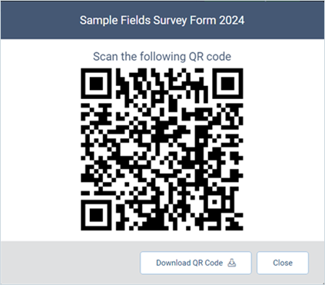
Share Menu & Analyze Menu
Share Menu
Copy Link & QR Code will produce a link to take the survey. This survey level link will automatically start a new instance if one is needed.
Analyze Menu
Once there is at least one completed instance of the form, the Add New Compylation option appears for creating calculations in Analytics.
Download Data button exports the survey or note form records as a CSV file, which will appear on the Data Collection > My Downloads page.

Slide 10
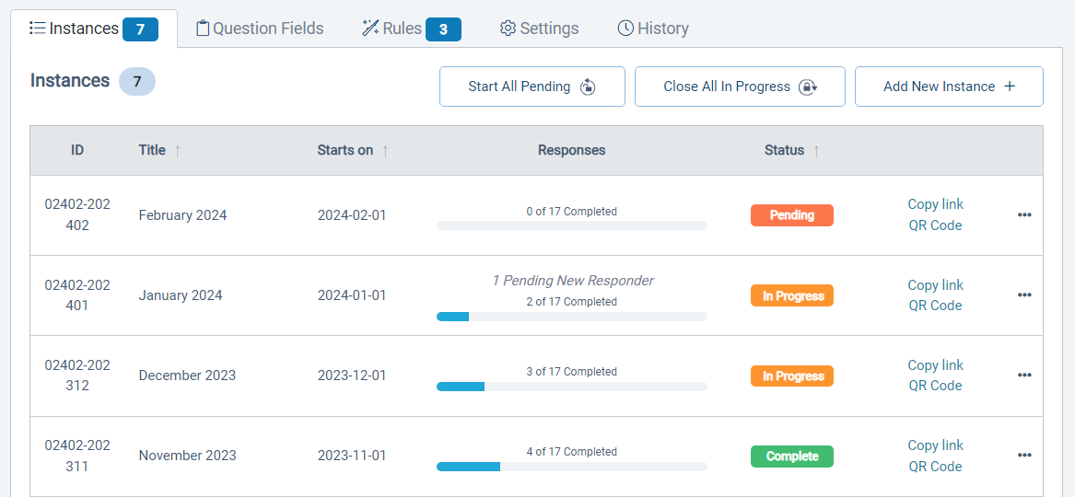
Instances Tab
  View all instances of the survey or note form
  Start All Pending instances
  Close All in Progress instances
  Add New instance
  See Pending Responders waiting to be accepted before their response displays

Slide 11
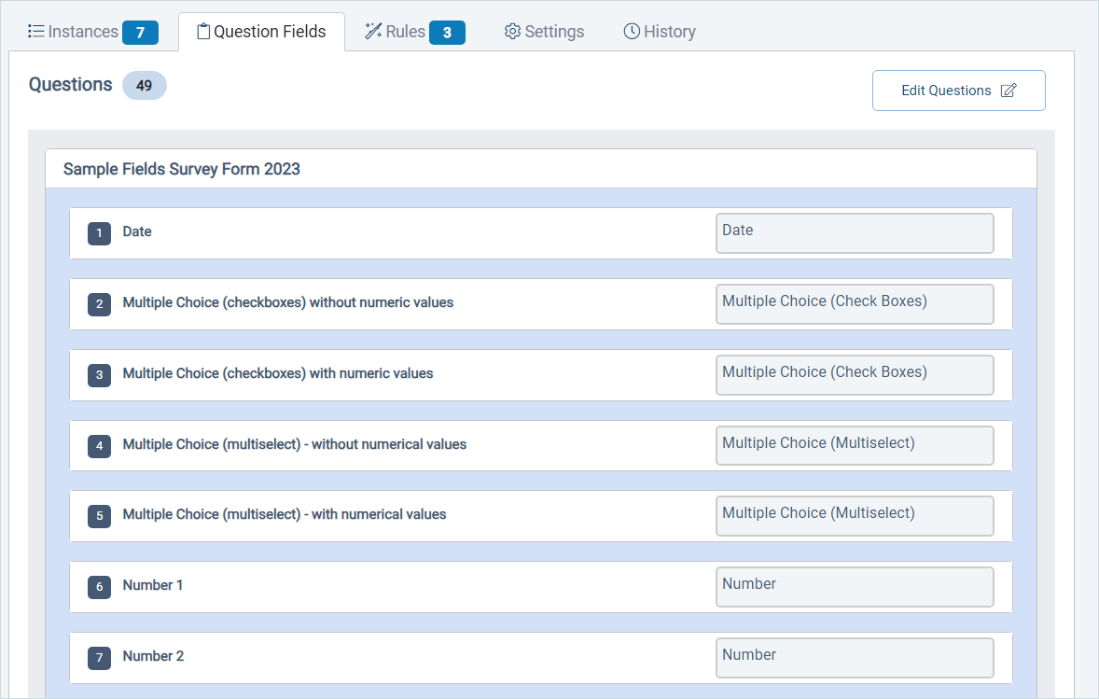
Question Fields Tab
  View all sections and fields present on the form
  Hidden fields are italicized
  All sections are expanded for ease of editing whether they are set to closed or expanded for data entry.
  Editing allows you to add, hide, edit, archive, or remove fields and sections. Fields can be reordered.

Slide 12
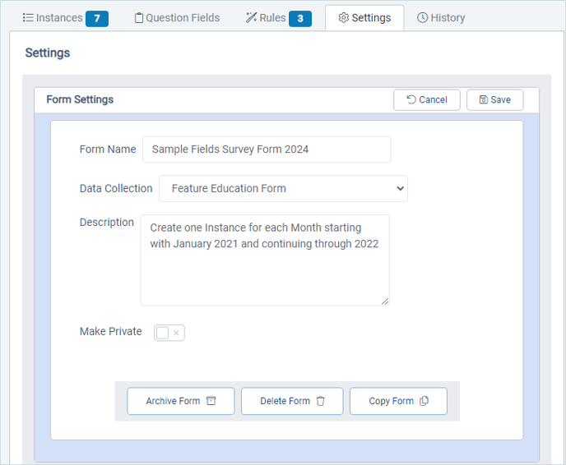
Settings Tab: Form Settings
Rename the form
Move it to a different Data Collection category
Update the description
Make it private to restrict viewing responses to administrators
Archive it (Recommended!)
Copy it
Delete only if there are no instances of it.

Slide 13
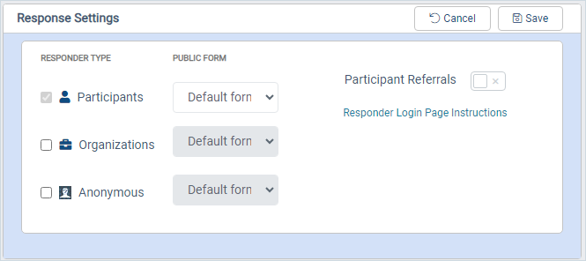
Settings Tab: Response Settings
Choose who the form can be completed for
Set the Public Form, which is the custom version of the Participant, Organization, or Anonymous form that new responders will be prompted to complete.
Allow External Participant Referrals
Customize instructions for returning responders

Slide 14
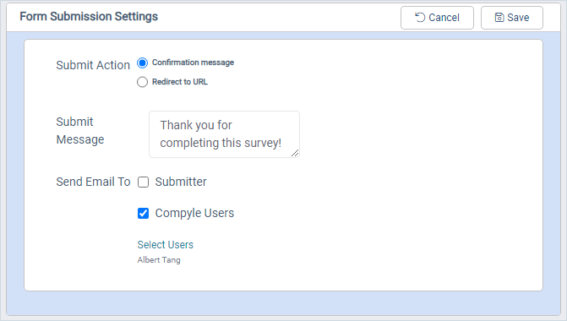
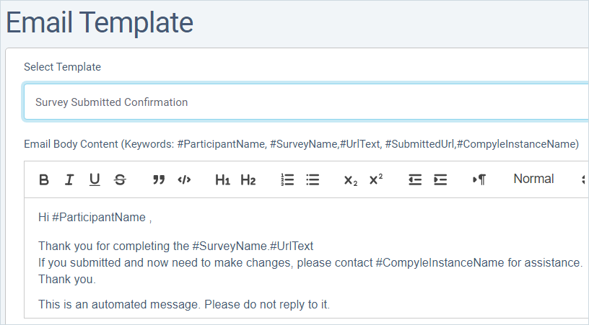
Settings Tab: Form Submission Settings
Set a thank you message or a redirect link for users after they submit the form.
Send the participant a confirmation email.
Choose Compyle users to email when new responses are received.

Slide 15
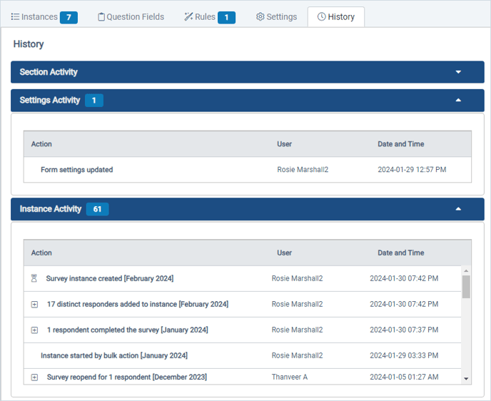
History Tab
  On the History tab, you can:
  View a record of changes to the form settings
  See all of the activity for all instances of the form.
  None of the information on the History tab can be changed on this tab, but changes made to the form instances, fields, and settings will appear here

Slide 16

Form Logic Rules

Slide 17
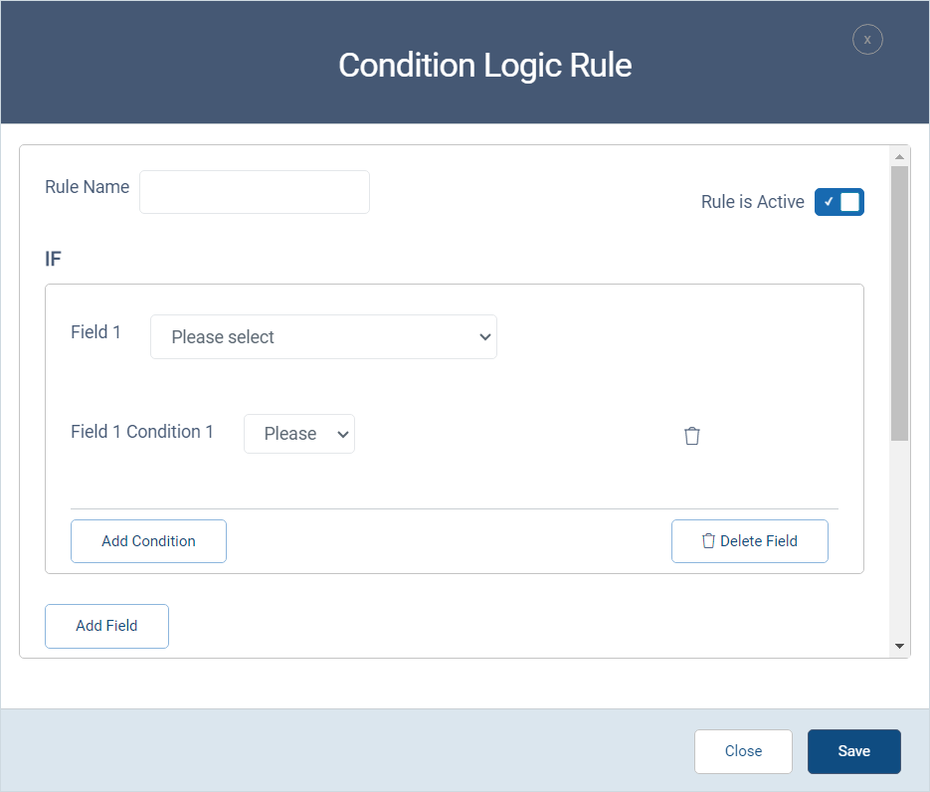
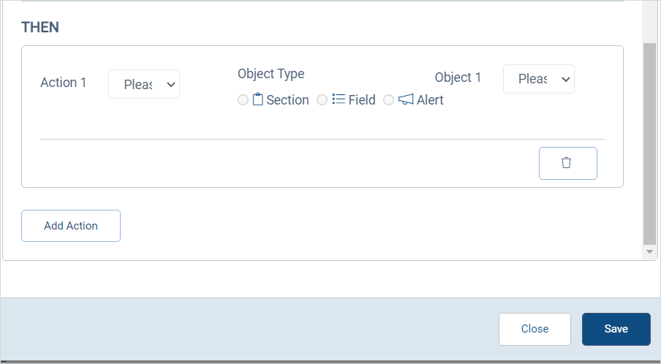
Form Logic Rules
Rules are If-Then statements based on conditions (field entries) and actions (alert, show, hide, require, expand).
These skip logic statements allow you to create different data entry paths or branches for users based on what is entered earlier in the form.

Slide 18
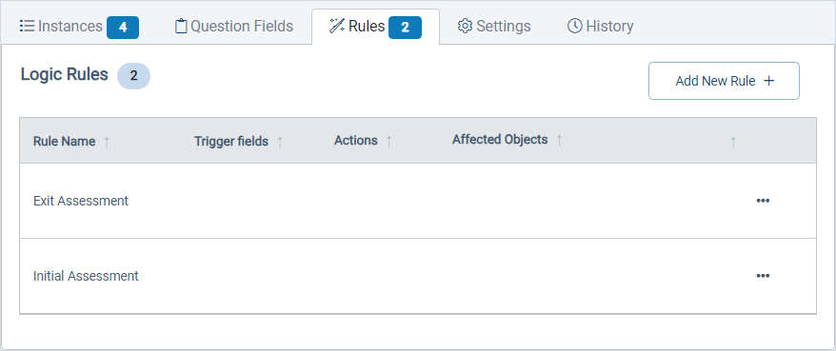
Form Logic: Creating A Rule
Rules can be applied to single fields or entire sections at once
Logic rules can be added to new and existing forms.
Rules copy when surveys are copied.
An existing rule can be copied for the same form if similar rules are needed.

Slide 19
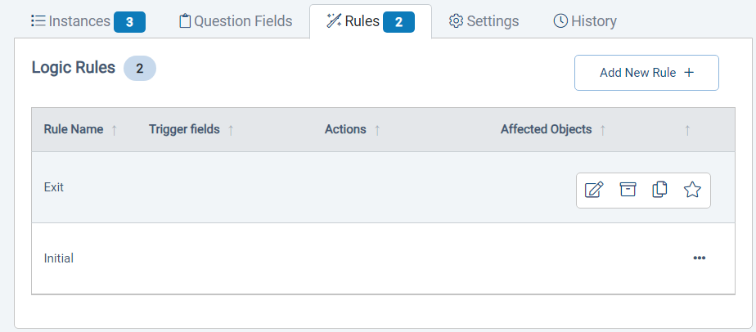
Form Logic: Editing & Copying Rules
Rules can be applied to single fields or entire sections at once
Logic rules can be added to new and existing forms.
Rules copy when surveys are copied.
An existing rule can be copied for the same form if similar rules are needed.

Slide 20
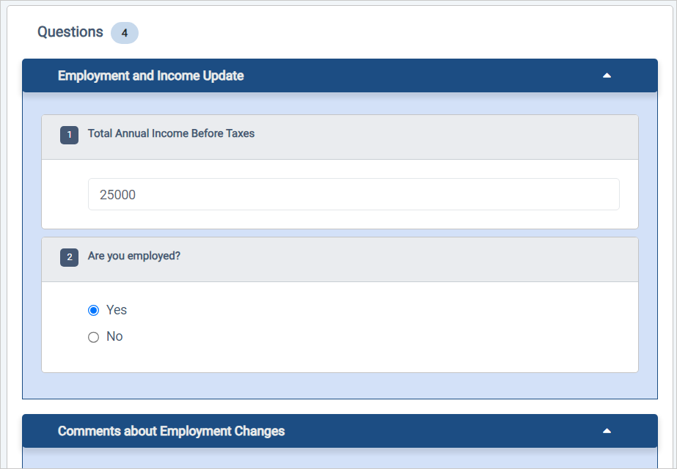
Form Logic - Exceptions
Form Logic Rules now apply when you fill out survey responses in Compyle as a user or as a participant working on a large device.
On mobile devices, rules only apply if the desktop mode is activated, which is the default now.
Exceptions
  Multi-entry forms do not apply logic rules.
  The survey instance question view does not show rules.
  Printing forms will include all visible by default fields and sections.

Slide 21
Form Logic vs Workflows
 | Form Logic | Workflow Logic
Status | Live as of 6 Feb. 2023 | Roadmap for 2024-2025
Admin Created Rules | Yes | Yes
Affects Forms | Single Survey/Note Form | Multiple Forms
Field Entries Determine | Required fields, visible fields, sections & pages available | Workflow enrollment
Rules Apply | When survey response is being completed | When various trigger actions occur
Group Assignments | No | Yes
User Notifications | No | Yes
Navigation Within One Form | Yes | Not Sure yet
Navigation Across Forms | No | Yes
Compyle’s Form Logic Rules are now live.
We are also starting to gather requirements for Workflow Logic Process Rules to automate client and user management for the future.
Here is how they differ.

Slide 22

User Communication Tools

Slide 23
Communication Tools
Form Management Folder
  All tabs: QR Code & Copy Link for Survey
  Instance tab: QR Code & Copy Link for specific Survey Instance
  Settings tab: Submission Settings: Send Submitter Email
Admin Menu
  Alert Templates: Customize the messages invoked by rules
  Email Templates: New Survey Submitter Confirmation emails
Data Entry
  Unsaved changes warning message

Slide 24

Assorted Refinements

Slide 25
Various Improvements
  Scorecard Feeds to Variable type measures for more disaggregated data analysis
  Behind the scenes changes for performance, security, and ease of use.
  Benefit: Things work better so users are happier and can more easily do what they need to do

Slide 26
Conclusion & Future Endeavors

Slide 27
Conclusion
Let’s see what we can create together next.

Slide 28
Resources & Reminders
Documentation
Release Notes: https://support.clearimpact.com/en/compyle-release-notes-form-logic-rules-survey-management-february-2024
Compyle Design: Field Types: pictures of field types in edit mode and entry mode: https://support.clearimpact.com/en/compyle-implementation-field-types
Form Logic Rules: Conditional Logic for Survey Forms and Note Forms
Form Logic: Tips & Tricks
Form Logic: Troubleshooting
Survey Form Management Interface
Alert Templates

Slide 29
Q & A
Any questions?

